Slide 1
Truss Problems

Slide 2
Overview
Planar 2 bar truss
Planar 3 bar truss
Planar Hoist comprised of truss elements

Slide 3
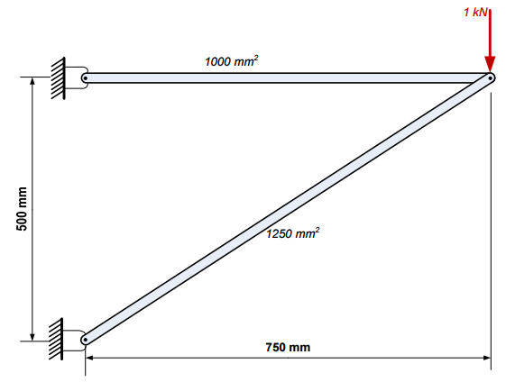
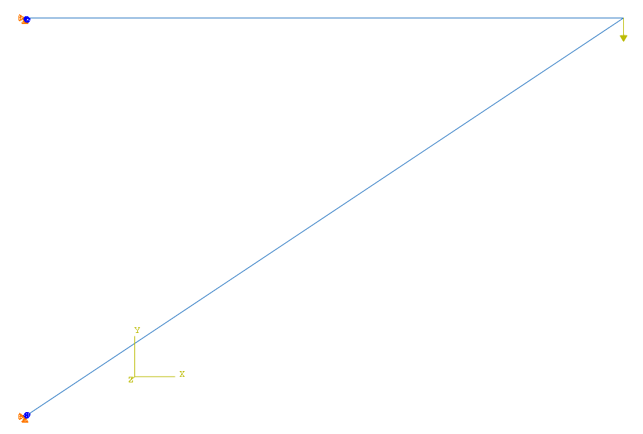
2 Bar Truss
FE Model
Fixed translation
Element 1
Truss 1 X-sec Area = 0.001m^2
Load = 1000N
Element 2
Truss 2 X-sec Area = 0.00125m^2
Material Properties:
Young’s Modulus = 210 Gpa
Poisson’s Ratio = 0.25
Fixed translation
Element Type:
ABAQUS linear truss element T2D2

Slide 4
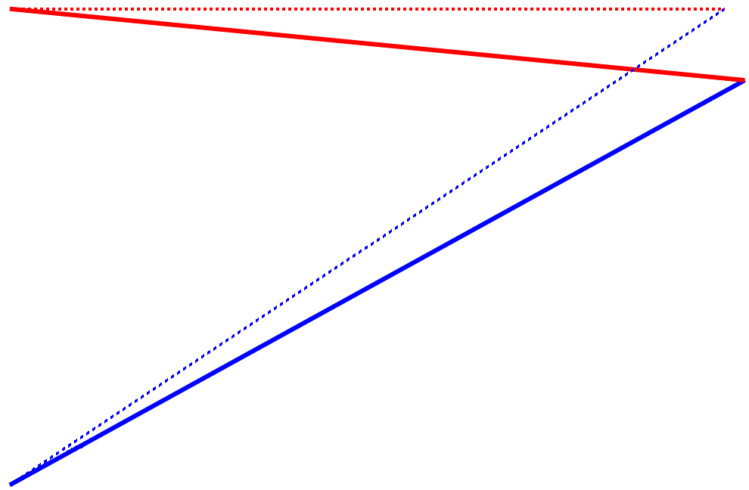
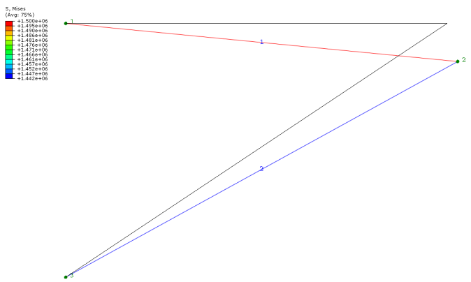
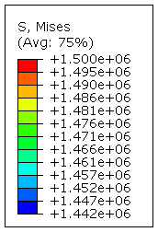
2 Bar Truss Results
S = 1.5 MPa
S = 1.5 MPa
Displacement = 0.019 mm
S = -1.44 MPa
S = -1.44 MPa
Example results from following source:
Intro to Finite Elements Class
Portland State University
Prof. Hormoz Zareh
Simulation results.

Slide 5
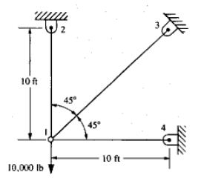
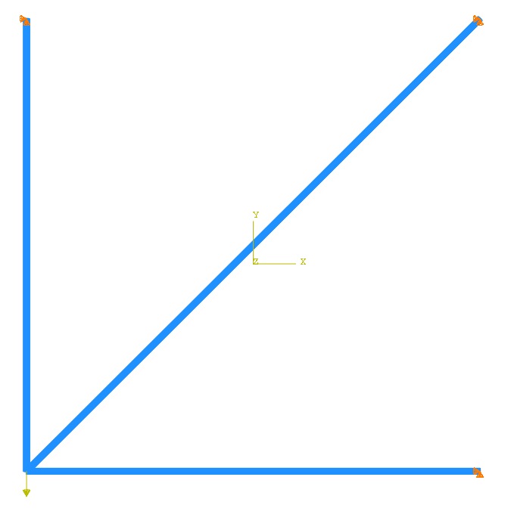
3 Bar Truss
FE Model
Fixed translation
Element 1
Fixed translation
Truss X-sec Area = 2 in^2
Element 2
Element 2
Fixed translation
Material Properties:
Young’s Modulus = 30,000 KSI
Poisson’s Ratio = 0.3
Load = 10000 lb
Element Type:
ABAQUS linear truss element T2D2

Slide 6
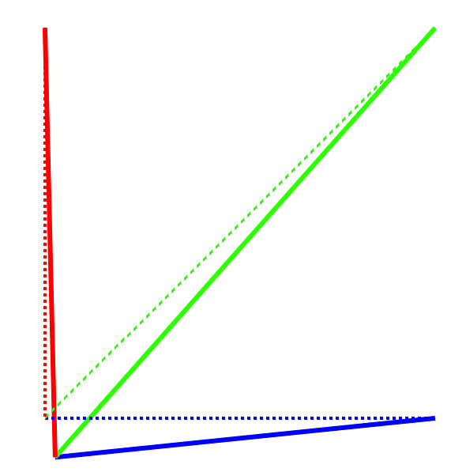
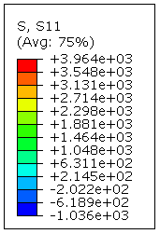
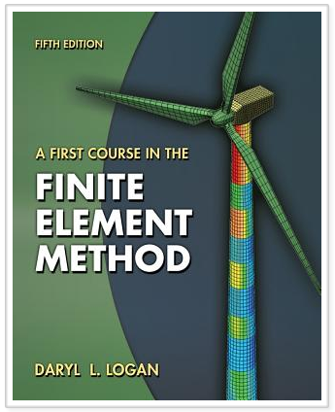
3 Bar Truss Results
S = 3964.5 psi
Book = 3965 psi
Example results from following source:
Ex 3.5 pp 81-84
S = 1464.5 psi
Book = 1471 psi
Solution
Ux = 0.004 in
Uy = -0.0159 in
Mag = 0.0163
S = -1035.5 psi
Book = -1035 psi
Book
Ux = 0.004 in
Uy = -0.0159 in
Mag = 0.0163

Slide 7
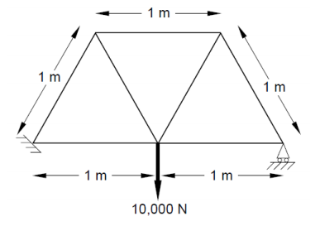
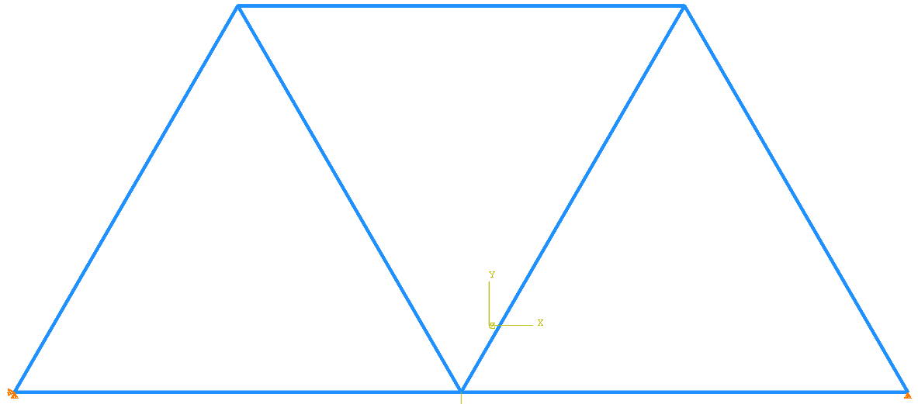
Truss Hoist
FE Model
Truss X-sec Area = 19.634 mm^2 = 1.96349e-5 m^2
E 1
E 6
E 5
E 4
E 2
E 7
E 3
Fixed translation
Fixed translation, Y only
Load = 10000 N
Material Properties:
Young’s Modulus = 200e9 Pa
Poisson’s Ratio = 0.3
Element Type:
ABAQUS linear truss element T2D2

Slide 8
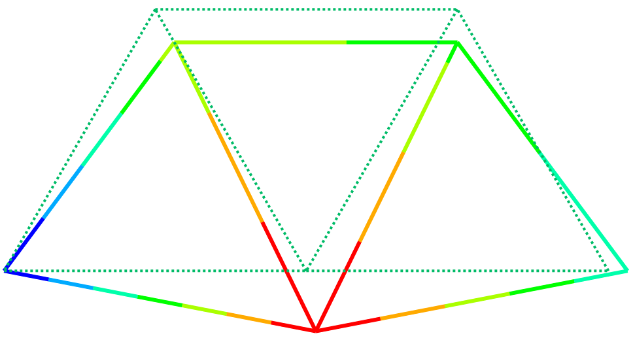
Truss Hoist
Sol Mag = 0.2546 mm
Book Mag = 0.2547 mm
Sol Mag = 0.2940 mm
Book Mag = 0.2941 mm
Example results from following source:
Intro to FEA class
Rensselaer Polytechnic Institute
Prof. Suvrano De
Sol Mag = 0.0 mm
Book Mag = 0.0 mm
Sol Mag = 0.1470 mm
Book Mag = 0.1471 mm
Sol Mag = 0.4726 mm
Book Mag = 0.4727 mm

